Slide 1



Sinapii Petroleum
View in Power BI
Last data refresh:
1/12/2026 9:55:12 AM UTC
Downloaded at:
1/12/2026 10:00:38 AM UTC

Slide 2
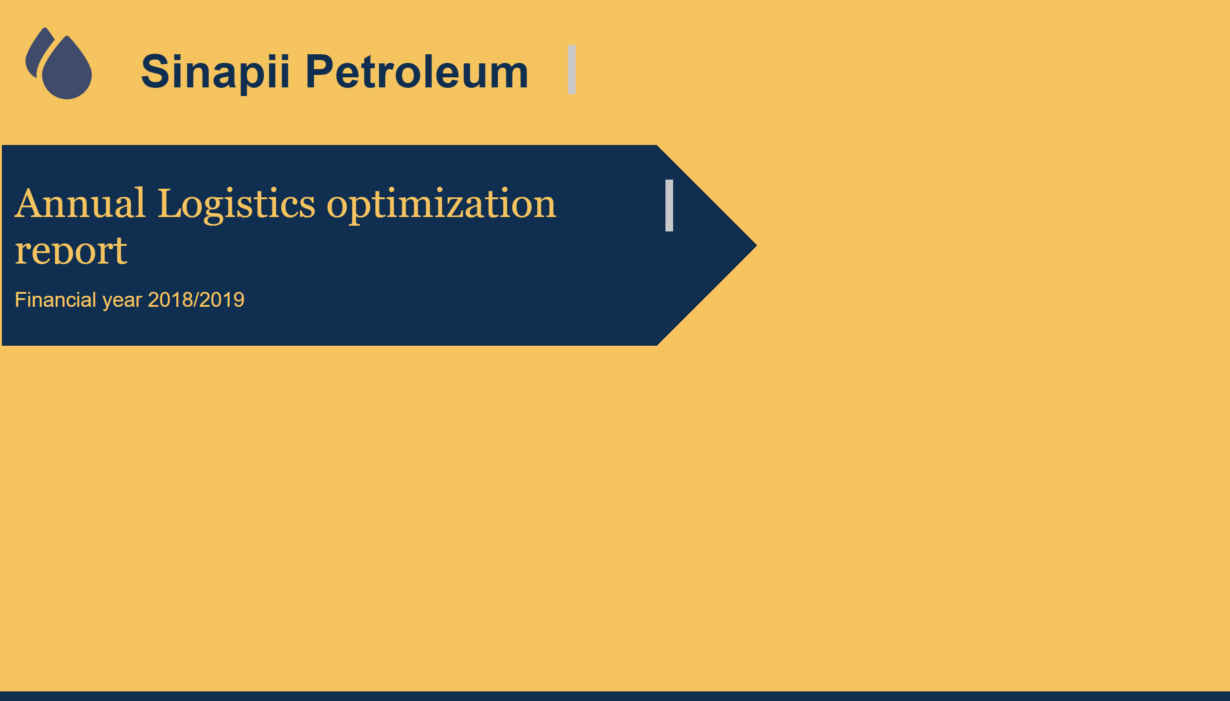
Intro
Notes:
image
No alt text provided
textbox
No alt text provided
textbox
No alt text provided
shape
No alt text provided
textbox
No alt text provided

Slide 3
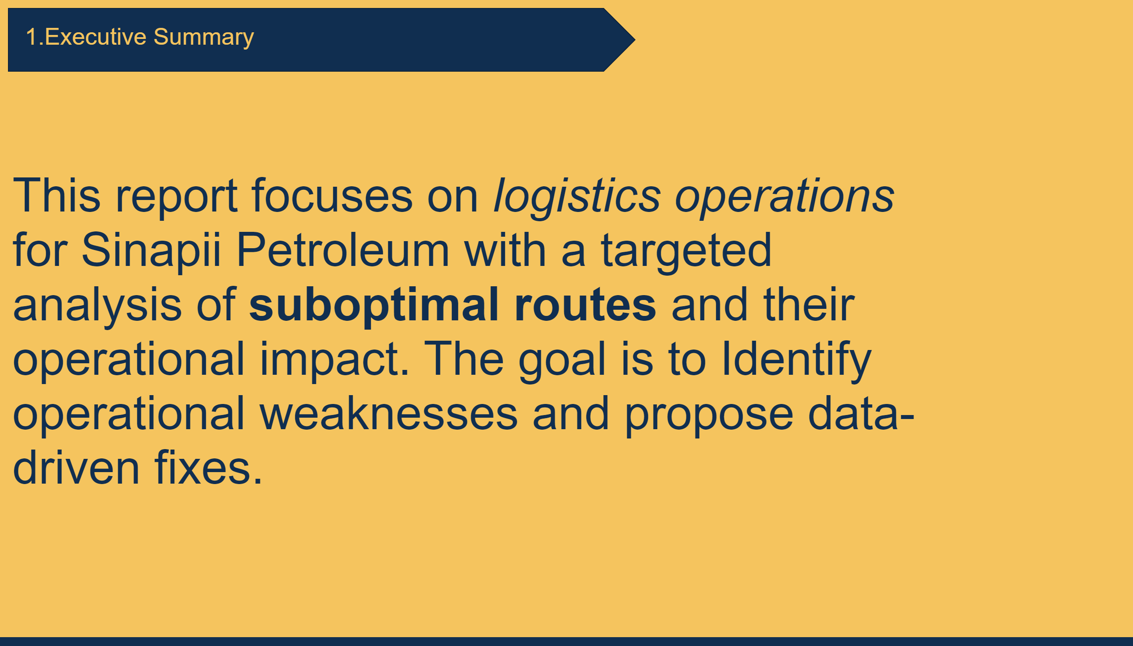
Executive Summary
Notes:
shape
No alt text provided
textbox
No alt text provided
textbox
No alt text provided

Slide 4
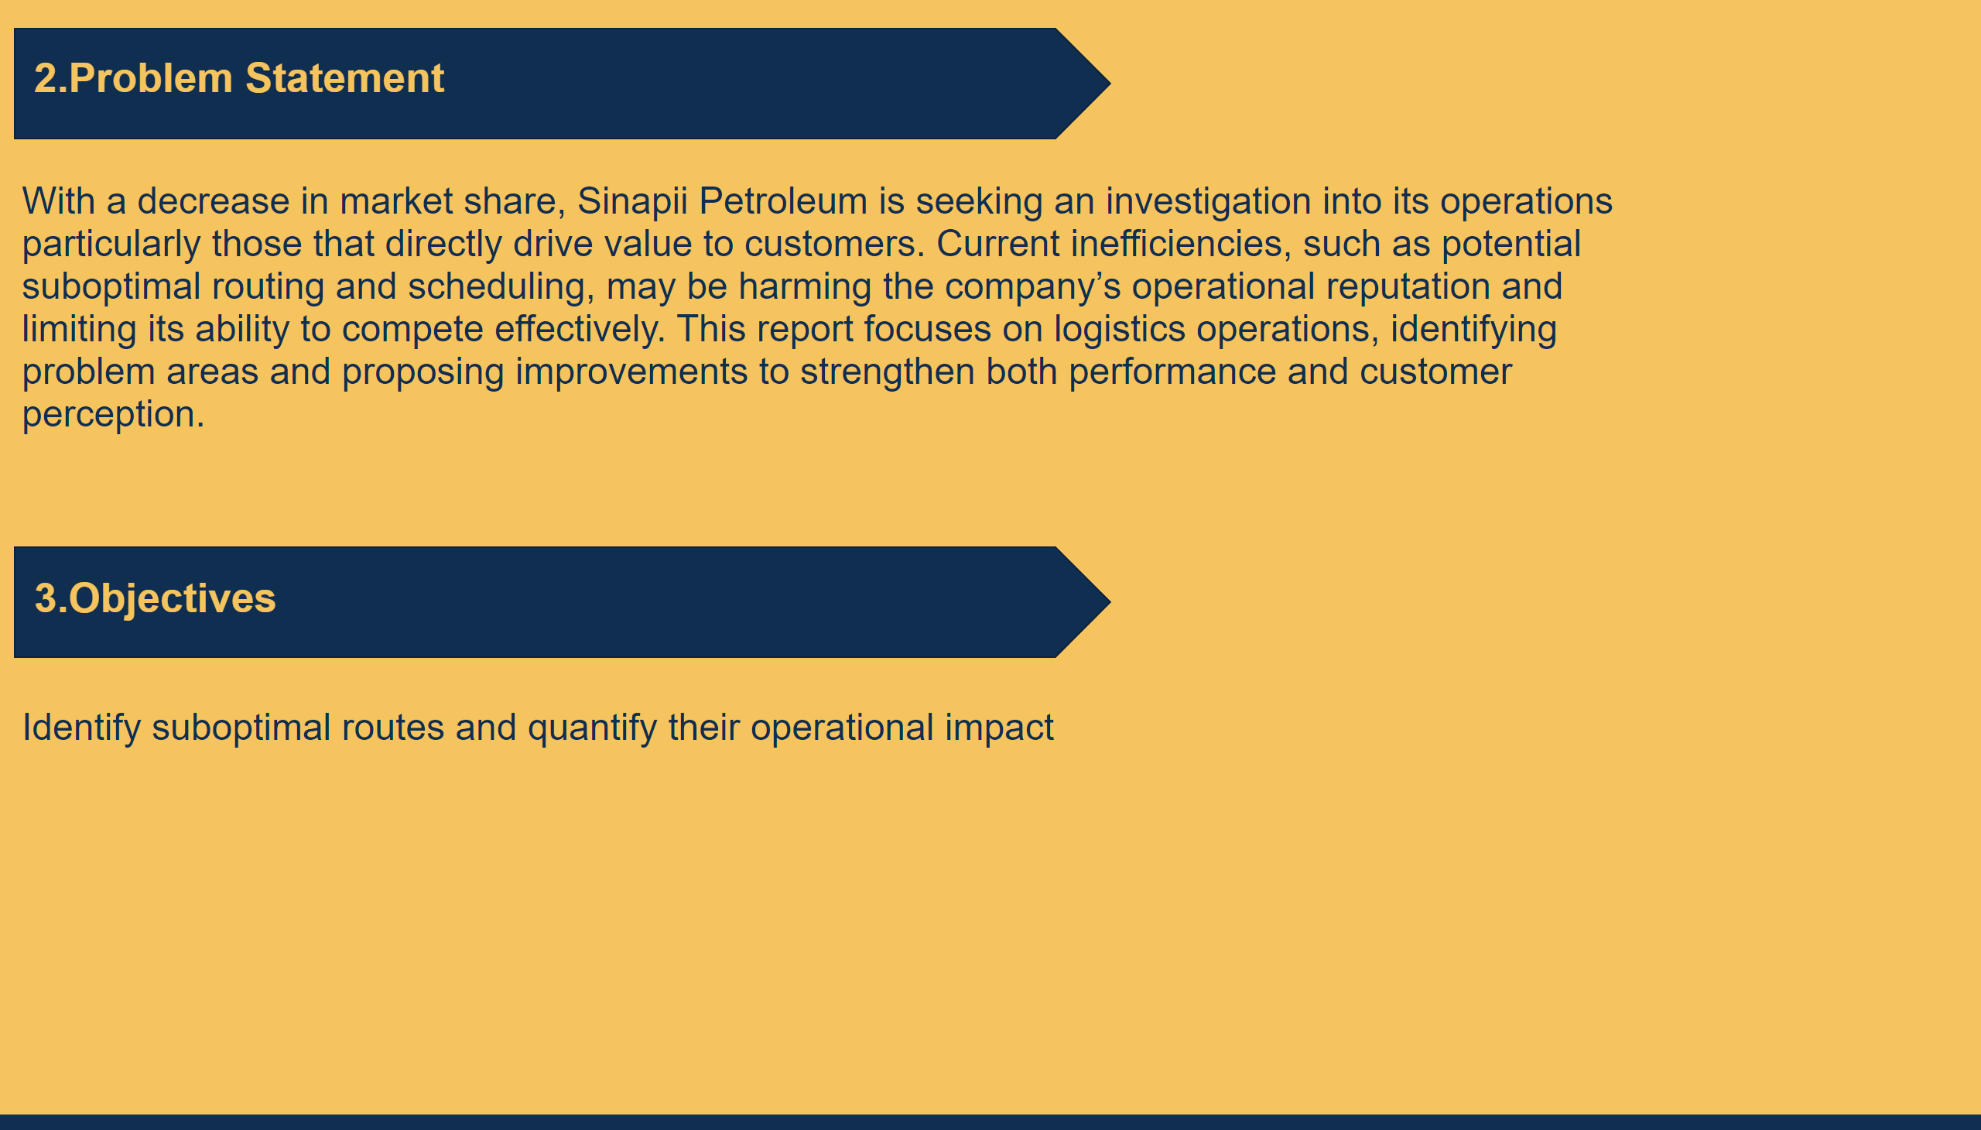
Problem statement & Objectives
Notes:
textbox
No alt text provided
shape
No alt text provided
textbox
No alt text provided
shape
No alt text provided
textbox
No alt text provided
textbox
No alt text provided

Slide 5
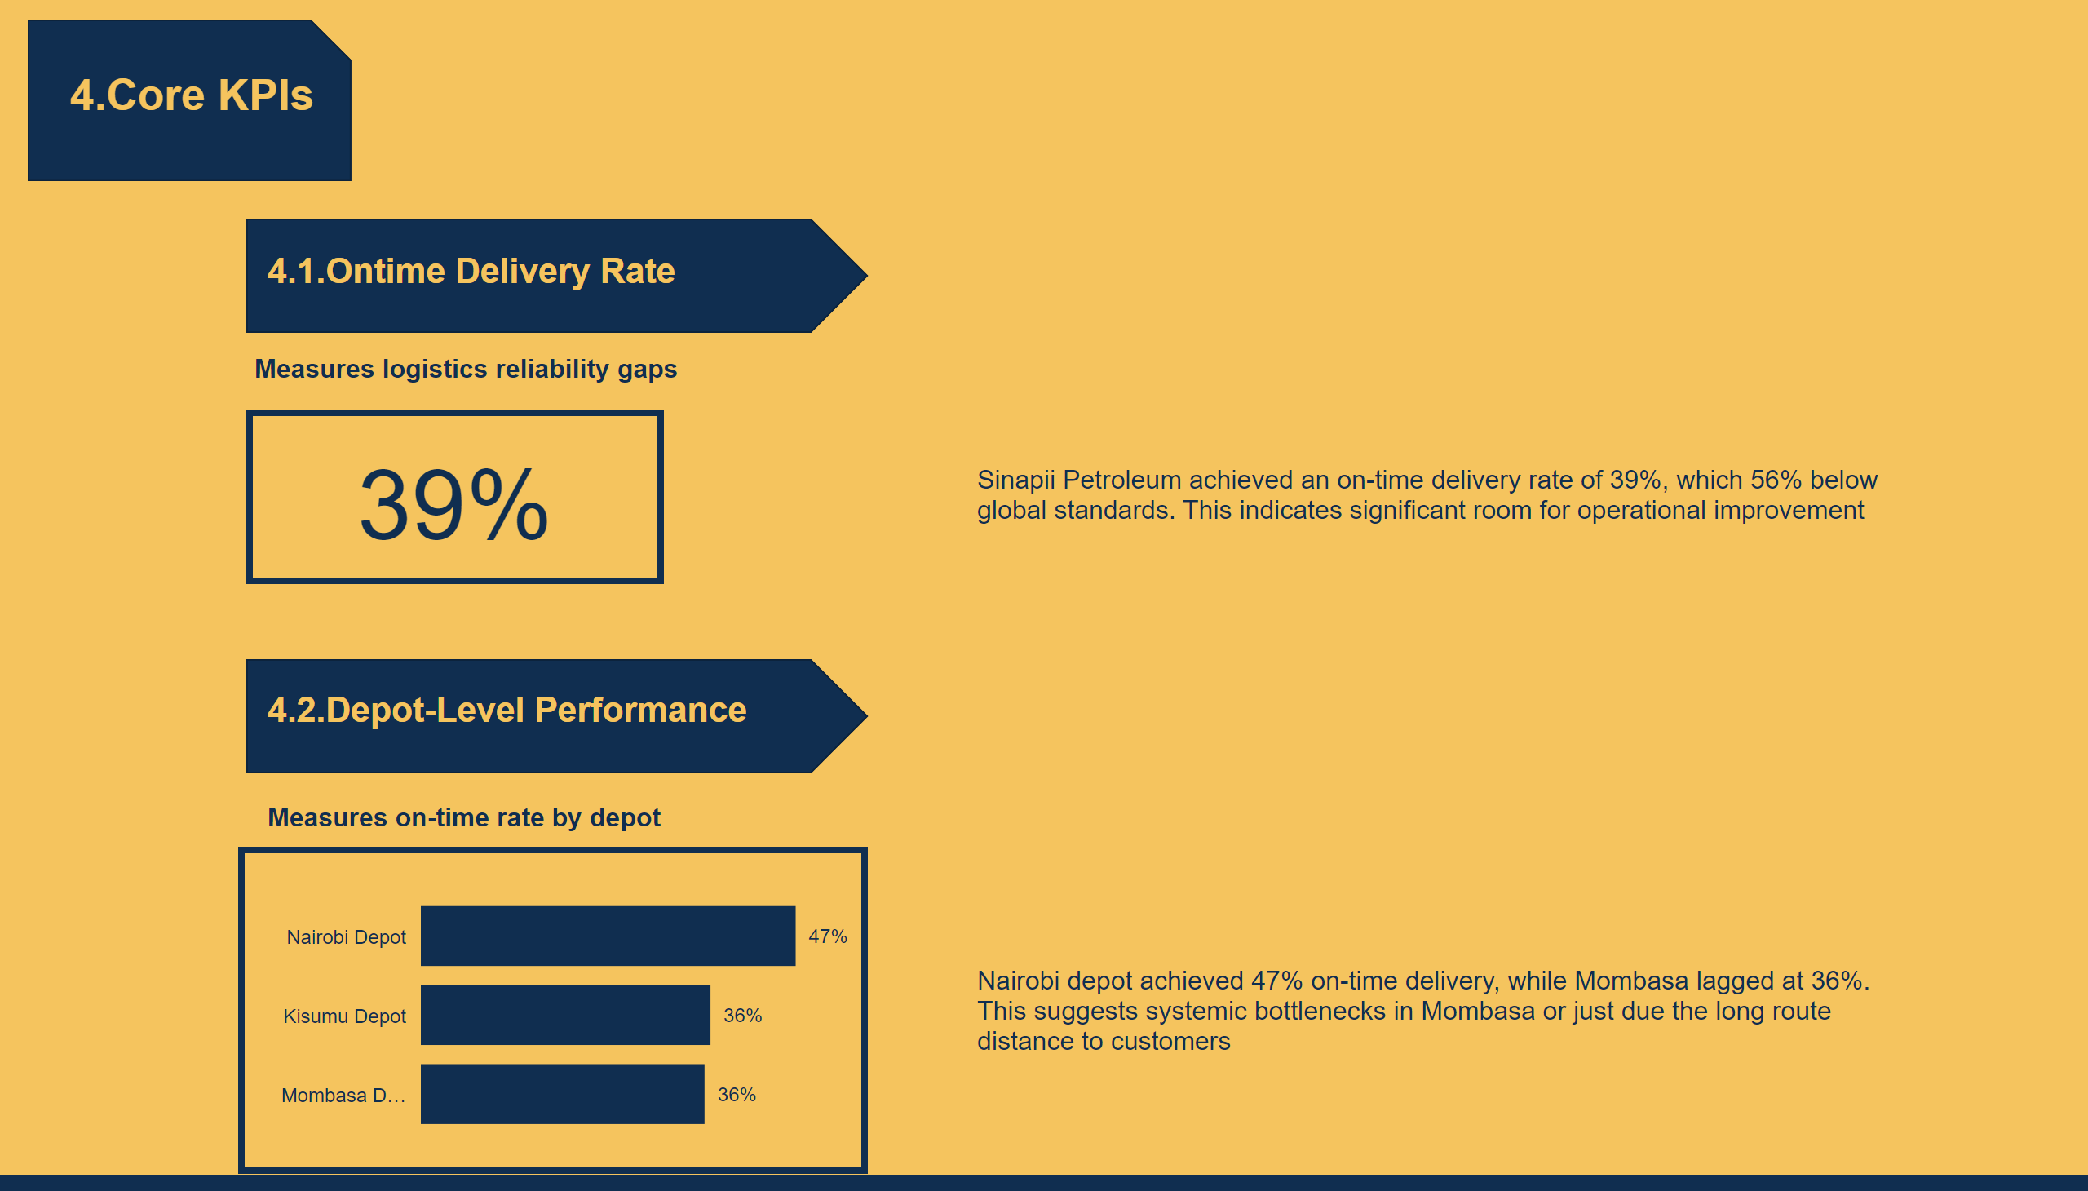
Analysis 1
Notes:
shape
No alt text provided
textbox
No alt text provided
textbox
No alt text provided
shape
No alt text provided
textbox
No alt text provided
card
No alt text provided
textbox
No alt text provided
textbox
No alt text provided
shape
No alt text provided
textbox
No alt text provided
On-time Rate By Depot
No alt text provided
textbox
No alt text provided

Slide 6
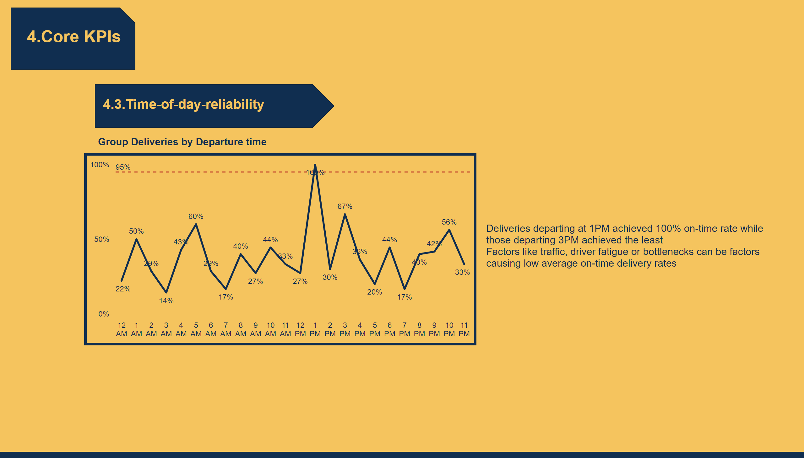
Analysis 2
Notes:
shape
No alt text provided
textbox
No alt text provided
textbox
No alt text provided
shape
No alt text provided
textbox
No alt text provided
textbox
No alt text provided
lineChart
No alt text provided

Slide 7
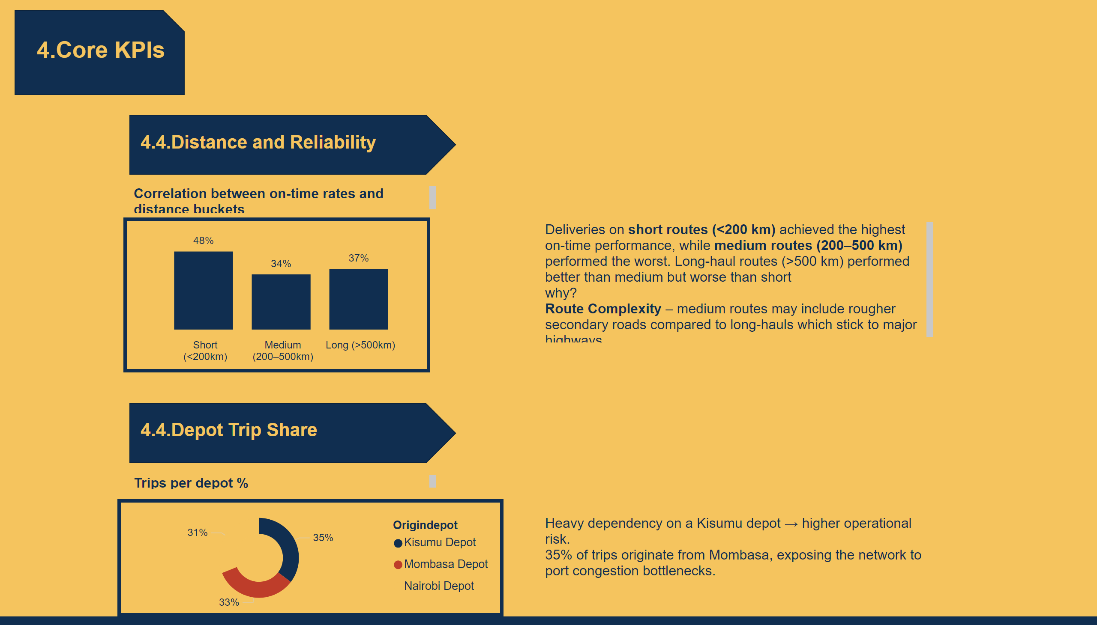
Analysis 3
Notes:
shape
No alt text provided
textbox
No alt text provided
textbox
No alt text provided
shape
No alt text provided
textbox
No alt text provided
textbox
No alt text provided
clusteredColumnChart
No alt text provided
donutChart
No alt text provided
shape
No alt text provided
textbox
No alt text provided
textbox
No alt text provided
textbox
No alt text provided

Slide 8
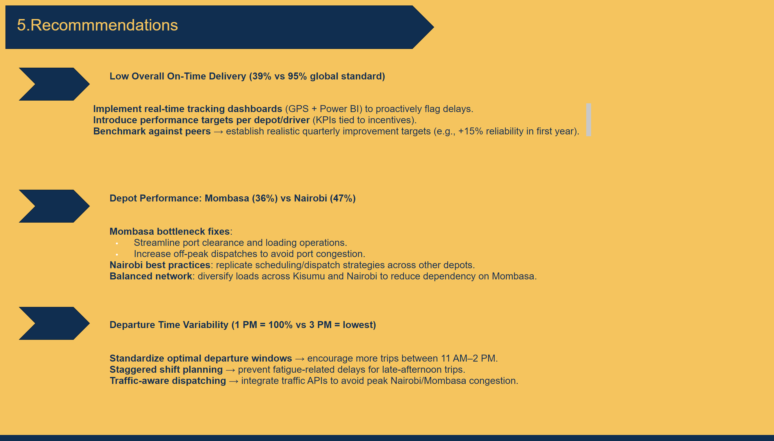
Recommendations
Notes:
shape
No alt text provided
textbox
No alt text provided
textbox
No alt text provided
shape
No alt text provided
textbox
No alt text provided
shape
No alt text provided
textbox
No alt text provided
textbox
No alt text provided
shape
No alt text provided
textbox
No alt text provided
textbox
No alt text provided

Slide 9
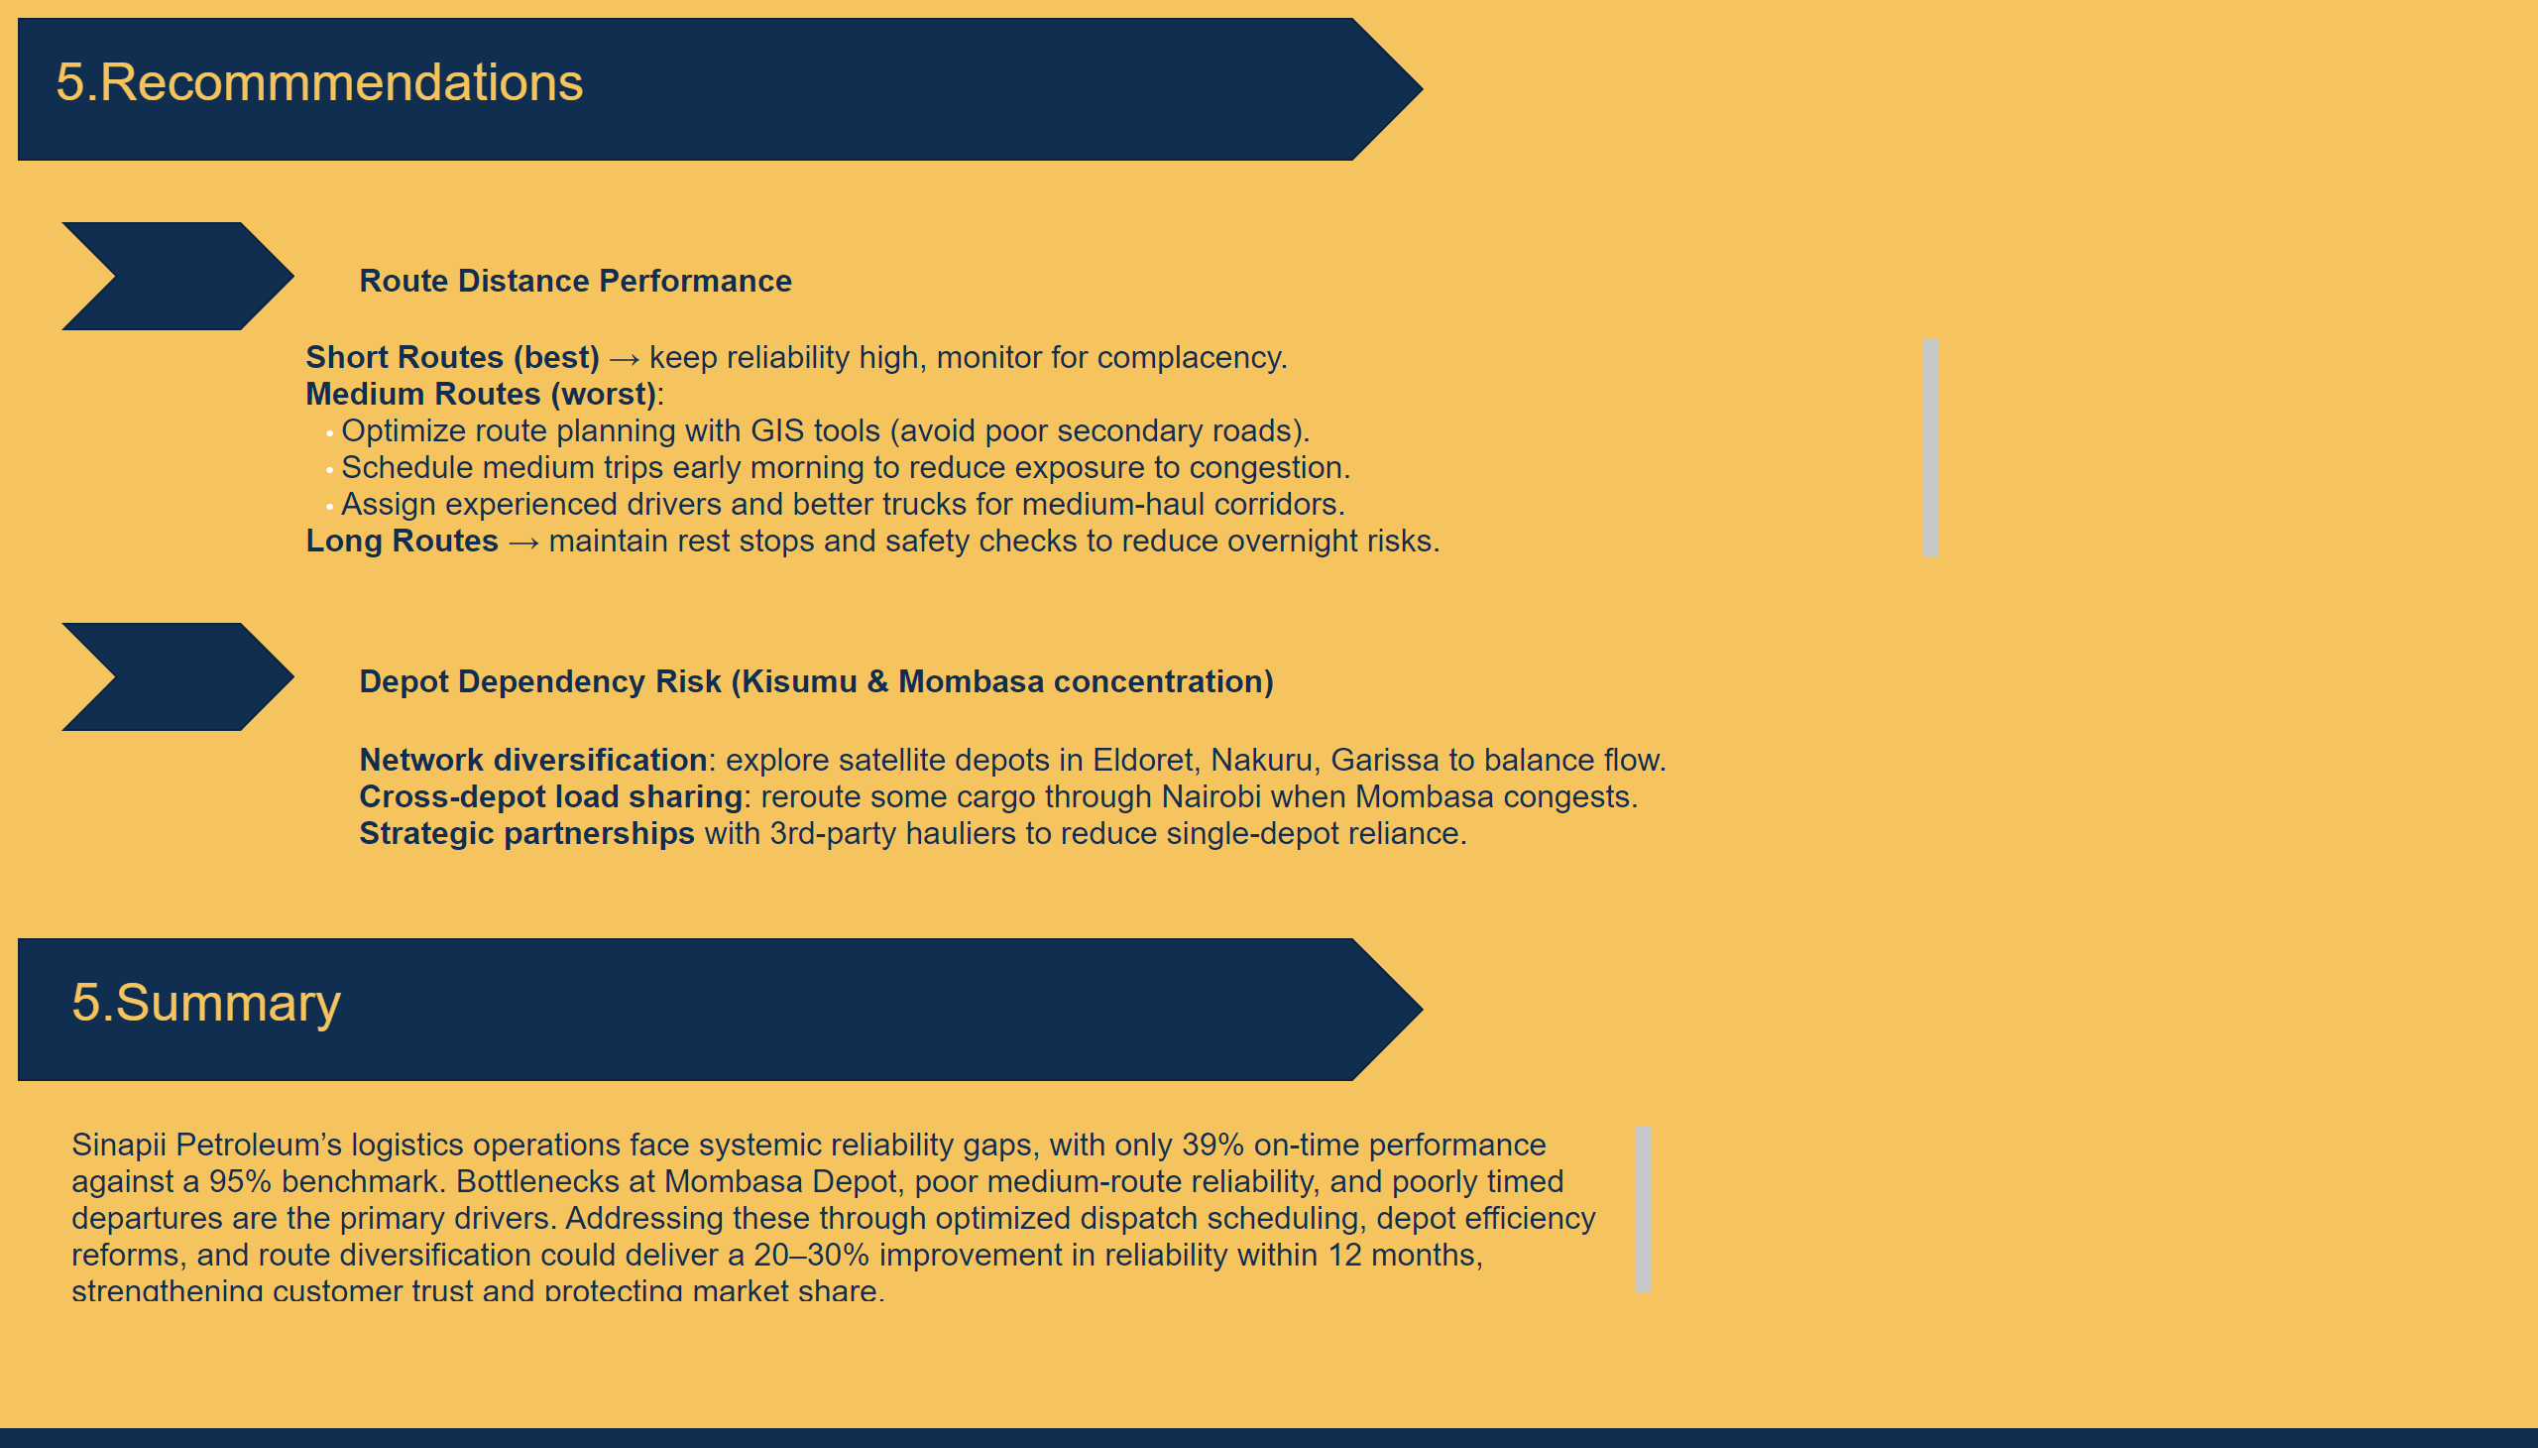
Duplicate of Recommendations
Notes:
shape
No alt text provided
textbox
No alt text provided
textbox
No alt text provided
shape
No alt text provided
textbox
No alt text provided
shape
No alt text provided
textbox
No alt text provided
textbox
No alt text provided
textbox
No alt text provided
shape
No alt text provided
textbox
No alt text provided

